Slide 1
Drivers / BIOS / Firmware
Installing, Updating, and Managing
Jon Anderson - @ConfigJon
Senior Systems Consultant at Now Micro, Inc.
BrainStorm 2020, Wisconsin Dells

Slide 2
Agenda
Drivers
  Bare Metal Deployment, In-Place Upgrade
  Existing Hardware
  Traditional vs Modern Management
  Vendor Tools
BIOS / Firmware
  Updates
  Password Management
  Settings Management

Slide 3
Vendor Driver Packs
Single download with all required drivers
Maybe too many drivers?
Drivers packs can be outdated
Vendor Links
  Dell Command | Deploy Driver Packs
  HP Driver Packs
  Lenovo Configuration Manager Driver Packs

Slide 4
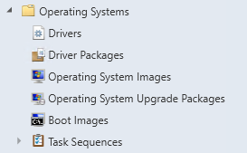
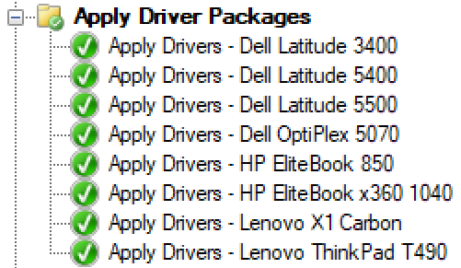
Traditional Driver Management
Built into Configuration Manager
No extra software or tools required
Driver repository can cause dependency issues making maintenance and cleanup difficult
Time consuming to update driver packs and task sequence steps

Slide 5
Traditional BIOS Update Management
Manual download and creation of packages
Script install with silent switches
Individual task sequence steps for each model
Time consuming to update BIOS packages and task sequence steps

Slide 6
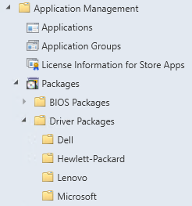

Modern Driver and BIOS Management
Third party scripts or tools (SCConfigMgr)
Automated driver package creation
Single dynamic task sequence step
Standard packages instead of driver packages
Limited support for legacy hardware
Works in Deploy, and Upgrade / Pre-Cache scenarios
Can be used for BIOS update packages

Slide 7
Modern Driver Management Setup
Install the Web Service
  ConfigMgr user facing server
  AD service account with read rights in ConfigMgr (CM-WebService)
  http://server.domain.local/ConfigMgrWebService/ConfigMgr.asmx
Install the Driver Automation Tool
  Configure connection to the ConfigMgr (or MDT) environment
  Configure package source location
Add the Invoke-CMApplyDriverPackage script to the task sequence

Slide 8
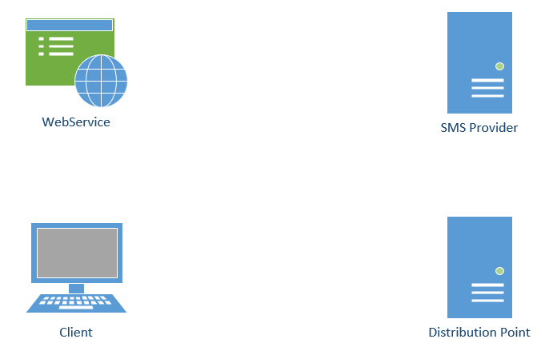
Modern Driver Management Communication

Slide 9
Demo
Driver and BIOS Management

Slide 10
Existing Hardware
When to update drivers and BIOS / Firmware?
Individual packages with scripted silent install
Vendor update catalogs and third-party updates in Configuration Manager
Microsoft Surface updates through WSUS

Slide 11
Vendor Tools
Dell Command | Update
HP Image Assistant
Lenovo System Update / Update Retriever

Slide 12
Dell Command Update
Installed on systems using a Win32 app or a UWP app
Scans local hardware then checks for updates against Dell’s website
  Can also be set to scan against a local repository
Can be run on a schedule
Can be run silently from the command line
Settings can be manually configured, exported to XML and imported via command line
  Dcu-cli.exe /configure -importSettings=“Settings.xml”

Slide 13
Dell Command Update
Run silent commands using the dcu-cli.exe located in Program Files(x86)\Dell\CommandUpdate
Silently install drivers and driver updates
  dcu-cli.exe /applyUpdates -silent -updateType=driver
  -reboot=disable
Silently install BIOS and Firmware updates
  dcu-cli.exe /applyUpdates -silent -autoSuspendBitLocker=enable
  -updateType=bios,firmware -reboot=disable

Slide 14
HP Image Assistant
Can be run from a standalone folder without being installed
Scans local hardware then checks for updates against HP’s website
  Can also be set to scan against a local repository
Can be run silently from the command line

Slide 15
HP Image Assistant
Silently install drivers and driver updates
  HPImageAssistant.exe /Operation:Analyze /Category:Drivers /Selection:all /Action:install /Silent /ReportFolder:C:\HPIA\Reports /SoftpaqDownloadFolder:C:\HPIA\Downloads
Silently install BIOS and Firmware updates
  HPImageAssistant.exe /Operation:Analyze /Category:BIOS,Firmware /Selection:all /Action:install /Silent /ReportFolder:C:\HPIA\Reports /SoftpaqDownloadFolder:C:\HPIA\Downloads

Slide 16
Lenovo Update Retriever, ThinInstaller, and System Update
Use Update Retriever to create a repository of drivers
Run ThinInstaller or System Update during a task sequence to install drivers from the repository
  Only system update supports cloud repositories
Apply all updates found for a system
  ThinInstaller.exe /CM -search A -action INSTALL -includerebootpackages 3 -noreboot -repository \\sccm\Lenovo\
  tvsu.exe /CM -search A -action INSTALL -includerebootpackages 3 -noreboot -repository \\sccm\Lenovo\

Slide 17
Demo
Driver and BIOS Updates with Vendor Tools

Slide 18
BIOS Passwords and Settings
Managed using vendor tools
  Dell Command Configure
  HP BIOS Config Utility
  Lenovo Think BIOS Config Tool
Managed using PowerShell
  Dell Command PowerShell Provider
  HP Client Management Script Library
  Native WMI classes (works for HP and Lenovo)

Slide 19
Inventory BIOS Settings
https://miketerrill.net/2016/03/22/how-to-inventory-lenovo-bios-and-uefi-settings-with-configmgr/
https://miketerrill.net/2016/05/08/how-to-inventory-dell-bios-and-uefi-settings-with-configmgr-part-1/
https://miketerrill.net/2016/01/31/how-to-inventory-hp-bios-and-uefi-settings-with-configmgr/

Slide 20
Questions?

Slide 21
Thanks for Attending!
Jon Anderson - @ConfigJon
Senior Systems Consultant at Now Micro, Inc.
BrainStorm 2020, Wisconsin Dells

